Slide 1

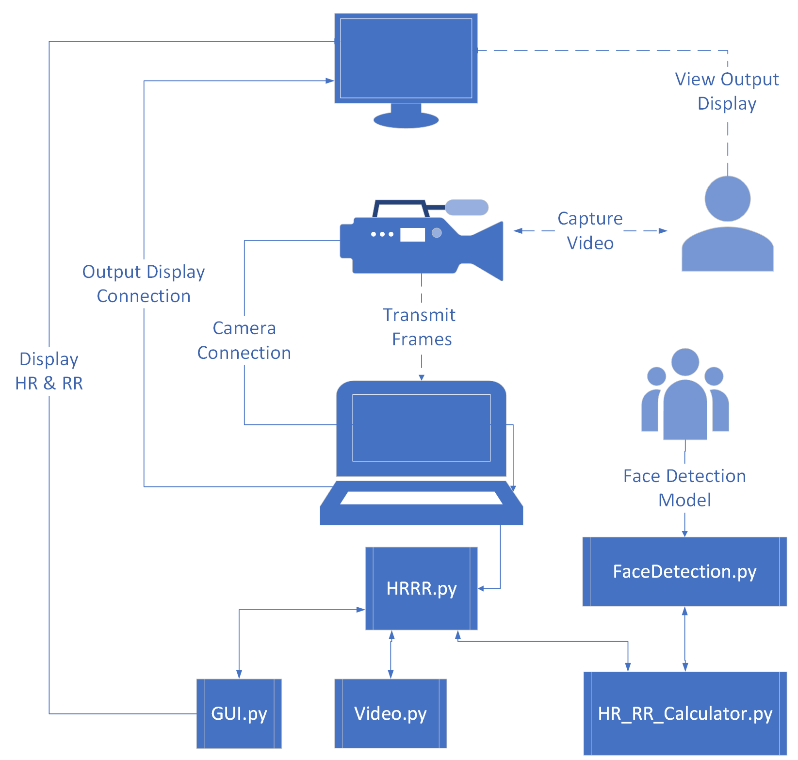
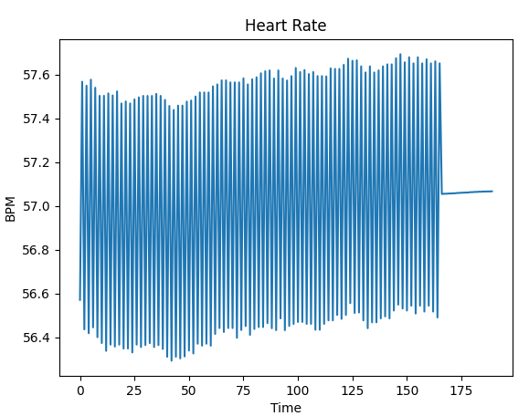
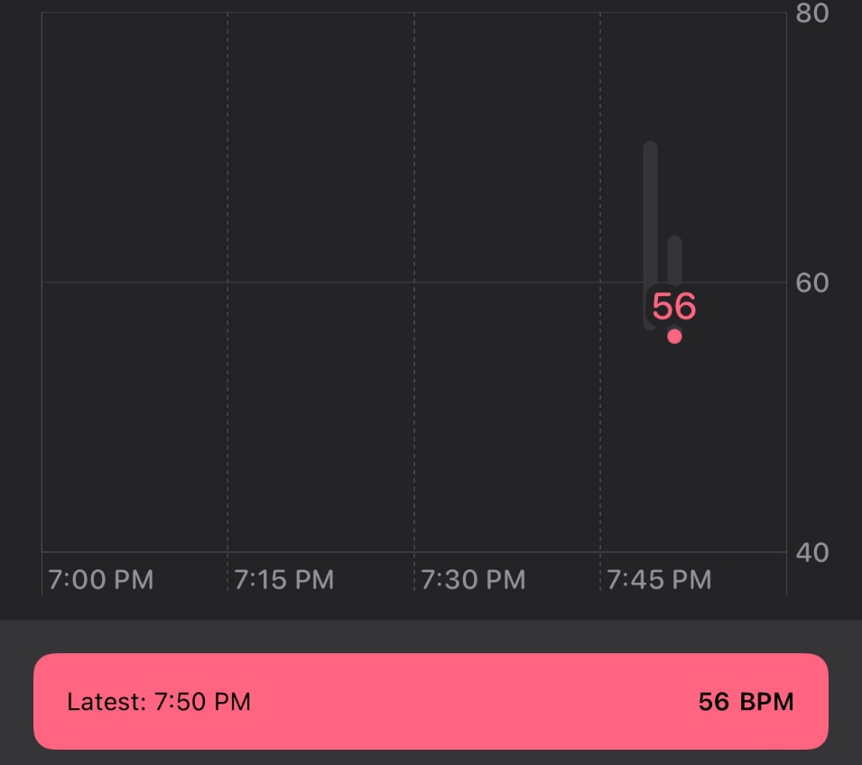
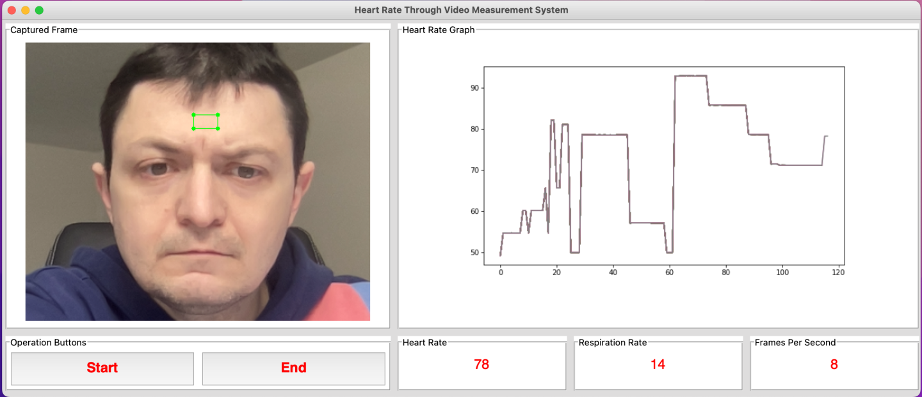
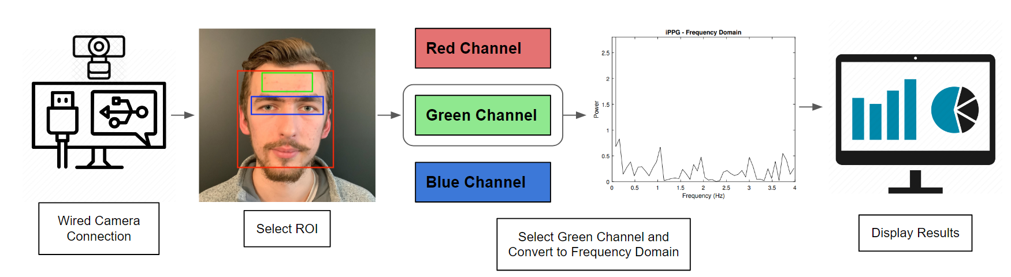
Contact-Free Heart and Respiration Rate Measurement System Based on Real-Time Human Face Video
Team Leader: Eugene Dobryakov
Team Members: Quan Nguyen, Roman Melnik
Faculty Advisor: Dr. Almabrok Essa, Department of Electrical Engineering and Computer Science, Cleveland State University
Electrical Engineering and Computer Science, Cleveland State University, Cleveland, OH 44108
115
E.Dobryakov@vikes.csuohio.edu
Abstract
The heart is at the center of the circulatory system, and one of the most important organs. It was imperative to have accurate readings when measuring a person’s heart rate (HR) and respiration rate (RR). There are currently no existing systems to measure a person’s HR and RR without making any physical contact. This presents an opportunity to develop a solution, especially during a global pandemic. The Contact-Free Heart and Respiration Rate Measurement System Based on Real-Time Human Face Video can measure accurate HR and RR in real-time. With a camera that can capture the person’s face and a display that can tell the vital information, anyone can have their HR and RR measured in a convenient and safe way.
Introduction and Background
The Current State
The electrocardiogram (ECG) is the current clinical standard for accurate HR measurement. However, it may cause tissue breakdown or skin irritation to the user.
COVID-19 is highly infectious and can spread from person to person. With current HR measurement methods requiring physical contact, the virus can spread through contact between individuals in the measurement process.
Studies have shown that elevated HR and RR are physiological signs associated with COVID-19, and early prediction of abnormally fast or slow HR and RR can prevent further dangerous situations.
Need a new lift and shift system capable of capturing the HR and RR contact-free in real-time.
With the current state of ongoing COVID-19 pandemic, this presents an opportunity to create a new lift and shift system that is capable of capturing the HR and RR in real-time and eliminating unnecessary contact during the process.
System Design and Algorithm
System Design
System contains an Intel RealSense D455 RGB-D camera, a Python program, and an output display.
Python program uses libraries such as OpenCV, NumPy, Dlib, CMake, ImUtils, SciPy, PIL, Matplotlib, and Tkinter.
Software Architecture
Python program consists of 5 files: Video.py, GUI.py, FaceDetection.py, HR_RR_Calculator.py, and HRRR.py
HRRR.py is the main file in this program to execute and kick off all other files.
Live video is received through a wired connection using Video.py.
GUI.py kicks off to create an interactive Graphical User Interface (GUI) template to display functional buttons, live video feed, and a graph for the HR and RR.
Region of Interest (ROI) is obtained with FaceDetection.py by using a pre-trained data model and plots landmarks on facial features to display the ROI.
Raw data from the green channel is extracted within the ROI bounds and processed by HR_RR_Calculator.py to produce a HR and RR.
Processed data is then displayed on GUI, alongside the live video feed, the ROI, and functional start/stop buttons.
Fig 3: Software Architecture Diagram
Experimental Results
Heart Rate Results
In order to validate if our data was accurate, the HR monitor application on the Apple Watch was utilized to compare and verify.
Figure 4 shows a graph of the HR during a test run. The program detected the HR to be at 56-57 beats per minute. Figure 5 shows the graph of the HR monitor from the Apple Watch during the test run. The Apple Watch detected the HR to be 56 beats per minute.
Fig 4: HR Testing Results
Fig 5: Apple Watch HR Monitor
Fig 1: GUI Layout
Respiration Rate Results
To test and validate our data for the RR, we counted the number of breaths taken in a 20 second time period and multiplied the result by 3 to get a breaths per minute number. The average RR for an adult is 12 to 16 breaths per minute according to Hopkins Medicine.
Figure 1 shows the RR of the user to be 14. During the test, the user recorded 5 breaths in the 20 second window, which comes to be 15 breaths per minute.
Conclusion and Future Recommendations
What we learned
Working with a team on a large project with real-world topic.
Media processing with Python libraries.
Developed a complete and functional program that meets the technical requirements and documented the process along the way
Recommendations
With more time, the HR and RR calculation logic can be improved to reduce noise.
This system can be implemented in fitness machines as a safety precaution to alert people if they’re HR is too high.
Fig 2: Technical Approach Process

